Slide 1

Airplanes in Cambridge
Key Stage Two

Slide 2
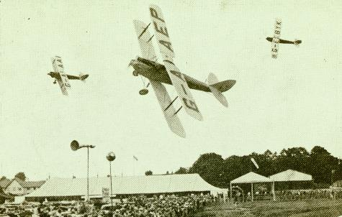
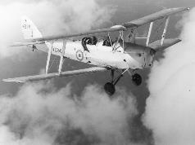
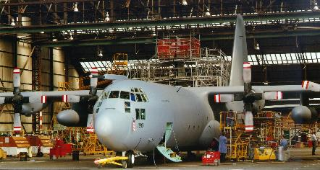
Did you know …?
Cambridge is well known for its university.
Cambridge has also played an important role in the history of aviation (airplanes).
Many famous planes have been worked on by a business called Marshall here in Cambridge.

Slide 3
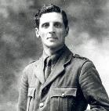
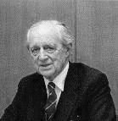
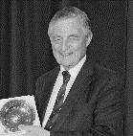
About Marshall
The Marshall Family
Marshall is a Cambridge business owned by a family.
Marshall started in 1909 – so it is over 100 years old.
Marshall is known for owning Cambridge Airport and for working on planes for air forces from across the world.
David Marshall (1873 - 1942)
David started the Marshall business. His first job was working in the kitchen apprentice at Trinity College, Cambridge.
Sir Arthur Marshall (1903 - 2007)
Arthur worked at Marshall for 80+ years. He was part of the athletics team for Great Britain in the 1924 Olympics.
Sir Michael Marshall (1932 - 2019)
Michael worked at Marshall for 60+ years. He rowed for Cambridge in the 1954 Boat Race.
Notes:
You can find out more about the Marshall family at: history.marshallgroup.co.uk

Slide 4
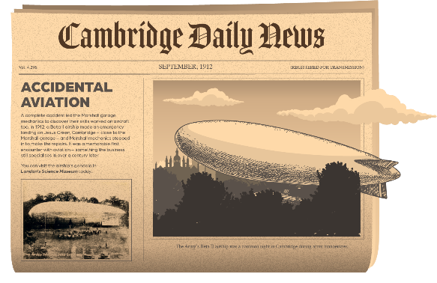
Find out more about Marshall
Marshall has created an interactive school-friendly version of its history.
The site uses old photos, documents, brochures and videos to bring the story of Marshall to life.
You can visit it at:
https://history.marshallgroup.co.uk/
Explore the website
What questions do you have about it?
Notes:
Marshall’s history website contains hundreds of old photos, documents and other resources.
It is scrollable content, using a lot of imagery and animation. It is suitable for school use.

Slide 5
Make a timeline
Looking at the website, find the dates for these events and write them in the blank spaces below.
Cut out the events and arrange them in the right order, starting with the earliest.
A Marshall hovercraft appears in a James Bond film.
Marshall opens its first aerodrome in Cambridge.
Richarda Morrow-Tait pilots a plane around the world.
The Brunswick Motor Car Company opens.
Marshall becomes the UK’s designated company for the RAF Hercules plane.
David Marshall starts work in Trinity College, Cambridge.
An air ship crash lands in Cambridge.
Marshall launches Marshall Thermo King.
A sled made by Marshall orbits the Earth 121 times.
Marshall opens a garage in Peterborough.
The first Chariots of Fire race in Cambridge takes place.
Marshall takes on its first apprentices
Notes:
Answers:
David Marshall starts work in Trinity College, Cambridge: 1887
The Brunswick Motor Car Company opens: 1909
An air ship crash lands in Cambridge: 1912
Marshall takes on its first apprentices: 1920
Marshall opens its first aerodrome in Cambridge: 1929
Marshall opens a garage in Peterborough: 1946
Richarda Morrow-Tait pilots a plane around the world: 1948
Marshall becomes the UK’s designated company for the RAF Hercules plane: 1966
Marshall launches Marshall Thermo King: 1972
A sled made by Marshall orbits the Earth 121 times: 1985
The first Chariots of Fire charity race takes place in Cambridge: 1992
A Marshall hovercraft appears in a James Bond film: 2002

Slide 6
Famous planes – all worked on in Cambridge

Slide 7
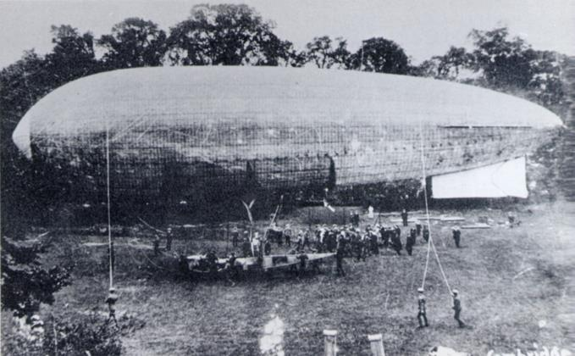
The start of aviation in Cambridge
An airship crash landed on Jesus Green, Cambridge in 1912.
Airships were one of the early forms of aircraft.
A local garage, Marshall’s, helped repair the airship.
After this repair, the garage decided to start an aviation business.
That business, Marshall, is still going today.
The Beta II airship on Jesus Green, Cambridge in 1912.

Slide 8
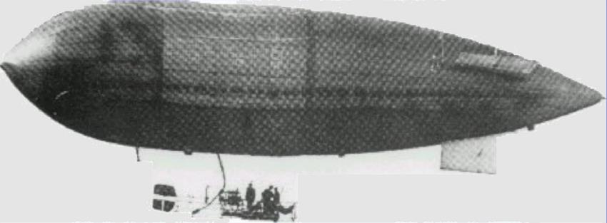
Beta II Airship
A Beta II airship in flight.
Beta II Facts
First flight: 1910
Crew: 3
Speed: 25 miles per hour
The airship balloon is filled with helium gas that is lighter than the air around the balloon. This means the balloon floats.
Airships have an engine and propellers. The engine and propellers power the airship to travel through the air.
Some people are interested in using airships in future as they are greener way to travel.
Notes:
Talking points: Airships were one of the earliest ways to travel by air.
They travelled very slowly – 25 miles per hour – compared to modern planes.
Airships were originally filled with hydrogen gas. Hydrogen is very flammable – and this led to some terrible accidents. People stopped using airships after these accidents.
Modern airships use helium. However, helium is limited in its supply.
Some people think airships could be the future as they do not emit fuel pollution like a plane. They are a greener and more sustainable way to travel.

Slide 9
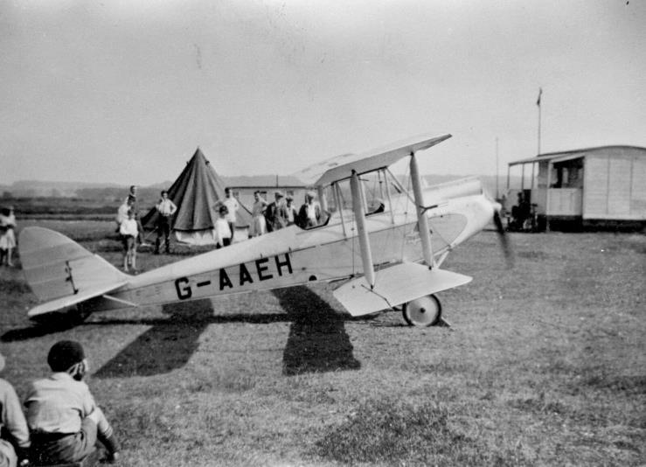
Gipsy Moth
A Gipsy Moth at Cambridge Airport.
The Gipsy Moth was a popular early plane.
Several of these planes were owned by Cambridge Airport.
They were the planes used to teach people to learn to fly.
Gipsy Moth Facts
First flight: 1925
Crew: 2
Speed: 102 miles per hour
Notes:
Talking point: The first ever plane was the Wright Flyer in 1903. The Gipsy Moth is only twenty years later – and already people are learning to fly. It is four times faster than the airship.

Slide 10
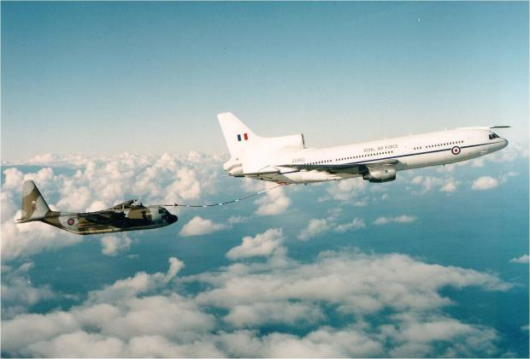
Lockheed L-1011 TriStar
The Lockheed L-1011 was a passenger plane.
It was used by airlines like British Airways to take people on their holidays.
Marshall in Cambridge changed the Lockheed plane so that it could also carry cargo for the Royal Air Force.
TriStar Facts
First flight: 1970
Crew: 4
Speed: 556 miles per hour
The Tri-Start plane on the right is sending fuel to the plane on the left.
Notes:
Talking point: the picture shows ‘mid-air refuelling’ – when one plane gives fuel to another plane while they are both flying. This technique was invented in Cambridge by Marshall.

Slide 11
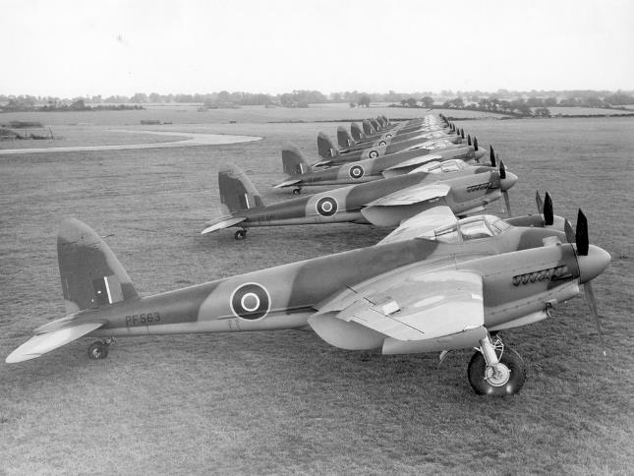
de Havilland Mosquito
Mosquitos after being repaired in Cambridge Airport.
The Mosquito was a plane that played many different roles in World War Two.
The Mosquito was made almost entirely from wood.
Mosquito Facts
First flight: 1941
Crew: 2
Speed: 407 miles per hour
Notes:
Talking point: The Mosquito was made entirely from wood, which meant it could be produced quickly and cheaply. But it was less robust than planes made from materials like metals.

Slide 12
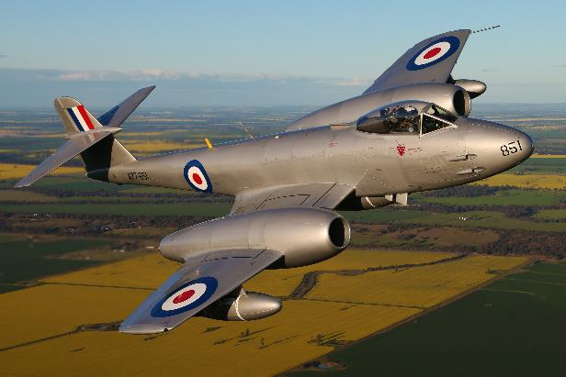
Gloster Meteor
The Gloster Meteor was the first plane to be fitted with jet engines.
Jet engines meant planes could fly further and faster than before.
The jet engine was invented by Frank Whittle, who studied at Cambridge University.
Meteor Facts
First flight: 1943
Crew: 1
Speed: 410 miles per hour
Gloster Meteors were repaired at Cambridge Airport during World War Two.

Slide 13
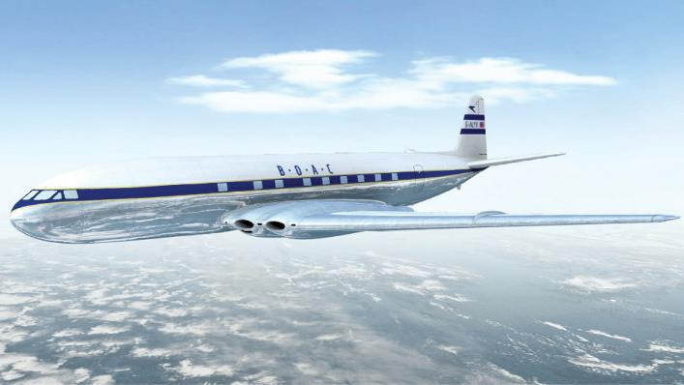
de Havilland Comet
The de Havilland Comet was the first passenger plane to use jet engines.
In its first year, the Comet carried 30,000 people on their travels round the world.
Comet Facts
First flight: 1949
Crew: 4
Speed: 460 miles per hour
de Havilland Comets were worked on at Cambridge Airport.

Slide 14
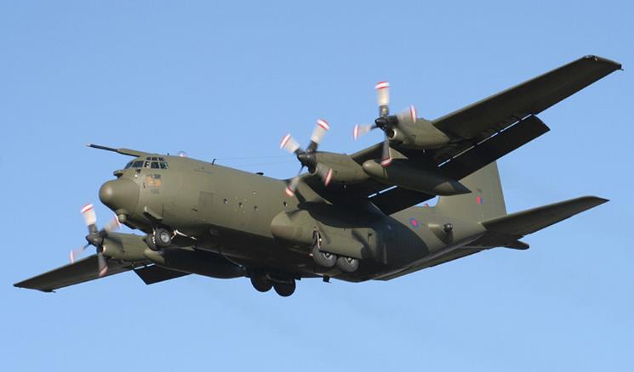
Lockheed C-130 ‘Hercules’
The C-130 is best known as a transporter plane, carrying people, medical equipment or other cargo.
It can carry cargo that weighs the same as 15 family cars.
C-130 Facts
First flight: 1954
Crew: 5
Speed: 370 miles per hour
C-130s were looked after by Marshall at Cambridge Airport for over 60 years.

Slide 15
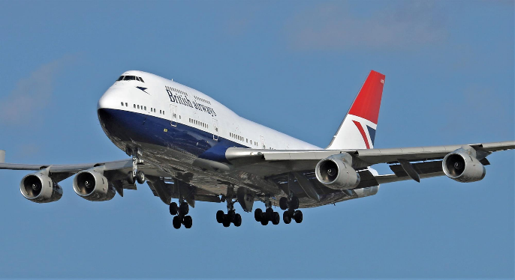
Boeing 747
The Boeing 747 was the world’s first ‘Jumbo Jet’.
It could carry more than 500 passengers and fly further than any other plane.
Many holidaymakers fly on Boeing 747s when travelling to another country.
747 Facts
First flight: 1969
Crew: 2 pilots
Speed: 579 miles per hour
Marshall worked on the passenger spaces inside of 747s at Cambridge Airport – including the television screens in the back of seats.

Slide 16
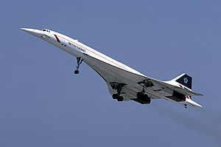
Concorde
The Concorde was the first passenger plane to fly ‘supersonic’ which means it could fly faster than the speed of sound.
It could fly from London to New York in 4 hours.
Concorde Facts
First flight: 1969
Crew: 3
Speed: 1,354 miles per hour
Concorde’s famous nose was designed right here in Cambridge by Marshall.

Slide 17
Test yourself
1. The plane that could fly at 1,354 miles per hour was ……………………………………………………………………………………
2. The plane made mainly from wood was ……………………………………………………………………..………………………………..
3. The name of the inventor of the jet engine is ……………………………………………………….……………………………………..
4. A type of gas that could be used to fill an airship is ………………………………………….…………………………………………..
5. The part of Concorde that was designed in Cambridge was …………….…………………………………………………………..
6. The plane that can carry more than 500 passengers is ………………..………………………………………………………………..
Notes:
Correct answers:
Concorde
Mosquito de Havilland
Frank Whittle
Helium (or hydrogen)
The nose
Boeing 747

Slide 18
Activity
Print the slides 7-16 about the planes on A5 paper and distribute one set per group.
In groups, talk about the images and what you notice in them.
Do planes get slower or faster over time?
How do the photos change over time?
What differences do you notice about how planes change over time?
What can you see in the background of photos?
Which plane would you most like to fly in?
Do planes get bigger or smaller over time?
Notes:
Talking points:
As a general rule, planes get bigger and / or faster over time – but it depends on the purpose of the plane. Concorde, the supersonic plane, was quite small as this allowed it to travel at supersonic speed.

Slide 19
Top Trumps!
Make Top Trump cards of the eight planes (leaving out the air ship). Draw a picture of each plane.
When you are ready, cut out your Top Trump cards and play against your classmates.
How to play
Shuffle your eight cards into a pile, making sure others can’t see them.
The first player chooses a category – first flight, crew or speed. Each player then has to read out what their top card has against that category.
The player with the fastest plane, oldest first flight and largest crew wins – and takes their opponents’ cards. If it is a draw, keep your cards but choose the next one in the pile. Continue until one person holds all the cards. They are the winner!
NAME
NAME
NAME
NAME
FIRST FLIGHT
FIRST FLIGHT
FIRST FLIGHT
FIRST FLIGHT
CREW
CREW
CREW
CREW
SPEED
SPEED
SPEED
SPEED
NAME
NAME
NAME
NAME
FIRST FLIGHT
FIRST FLIGHT
FIRST FLIGHT
FIRST FLIGHT
CREW
CREW
CREW
CREW
SPEED
SPEED
SPEED
SPEED
Notes:
These Top Trumps can be printed and cut out.

Slide 20
Cambridge’s role in keeping Britain flying in World War Two

Slide 21






Royal Air Force Pilots
In World War Two (1939-45), Cambridge Airport was one of the main centres for training pilots for the Royal Air Force (RAF).
One in six pilots trained in World War Two trained at Cambridge Airport.
Draw a circle around one in every six pilots on this page.

Slide 22
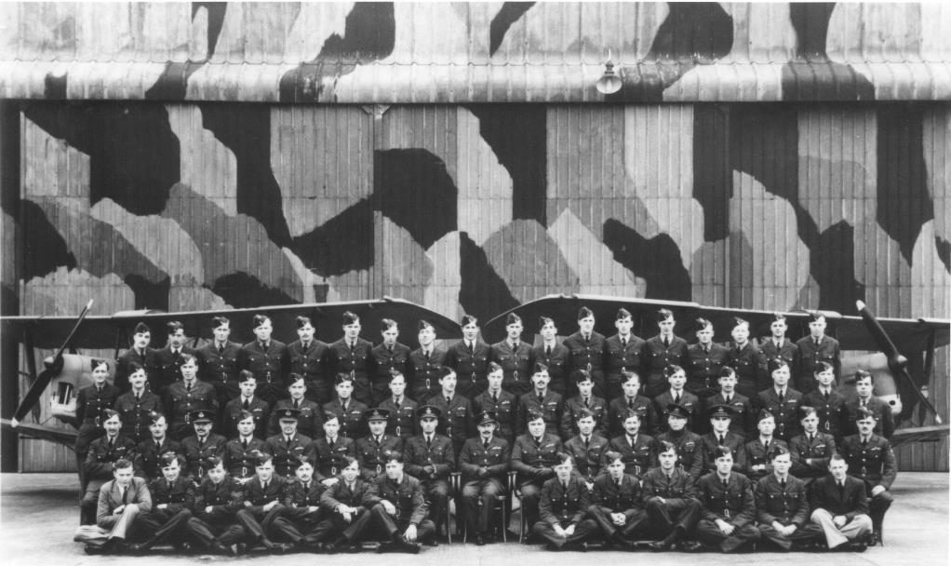
Here are some of the pilots who trained at Cambridge Airport during World War Two.
Why do you think the air hangar behind them has been painted with a pattern?
Notes:
Talking points:
The building has a camouflage paint decoration. Camouflage is a type of decoration that makes things harder to spot against a background of greenery.
The air hanger would have been painted to disguise it. It would have been a target for the enemy. Destroying an air hangar would probably destroy the planes within it.

Slide 23
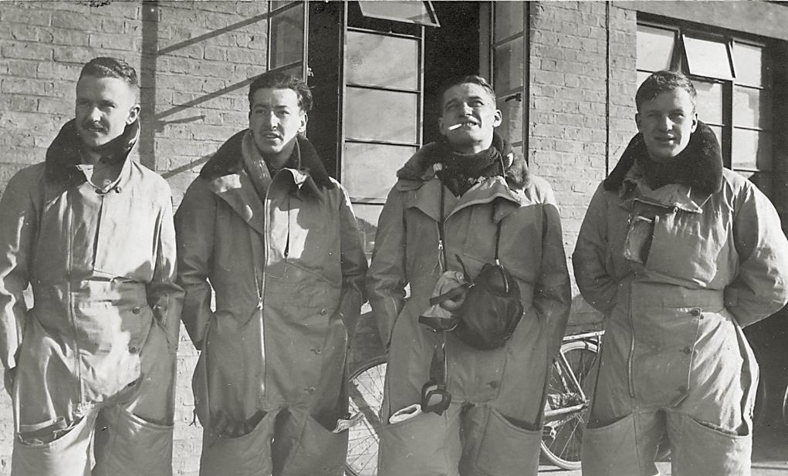
Here are some of the most famous pilots who trained at Cambridge Airport during World War Two. What do you notice about their clothes?
Notes:
Talking points:
The pilots are wearing very thick, warm clothing, including a lined collar.
The boiler suit also increases warmth as there are fewer gaps for body heat to escape and cold air to get in.
The boiler suit is made of practical, hard-wearing fabric, so it would last longer.
In WW2, planes had very little insulation and minimal heating – so staying warm was important for pilots and crew.

Slide 24
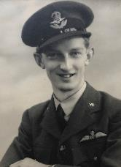
Understands how an aircraft works
Wing Commander Oliver Wells was a famous pilot who trained at Cambridge in World War Two.
Good at dancing
Can work as part of a team
Can perform magic tricks
Training to be a pilot
A fast runner
Can remain calm
Being a pilot requires a lot of training, skill, and bravery.
Which of these skills listed are most useful for a pilot?
Put ticks (✓) in the boxes next to the skills you think are most important.
Good at cooking
Speaks clearly
Can speak French
Can think quickly
Notes:
Some of the stronger suggestions are:
Understands how an aircraft works. This makes it easier to fly planes as you know what a plane can and can’t do. You can tell if your plane might need maintenance, for example.
Can work as part of a team. A WW2 plane might also include another pilot, a navigator to work out where to go, and a gunner to defend the plane, so they had to work as a team.
Can remain calm. Pilots have to make lots of decisions, and remaining calm helps them think more clearly. WW2 pilots were often flying under difficult circumstances, for instance, being attacked by enemy aircraft.
Speaks clearly – a pilot in WW2 had to give out orders under difficult conditions. It was important everyone could hear and understand them.
Can think quickly – the speed at which a plane can fly means pilots have to think quickly.
All the other skills are useful life skills – but aren’t necessary for being a pilot.

Slide 25
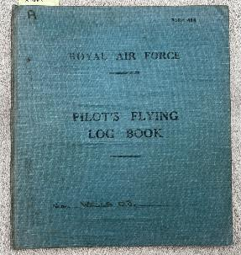
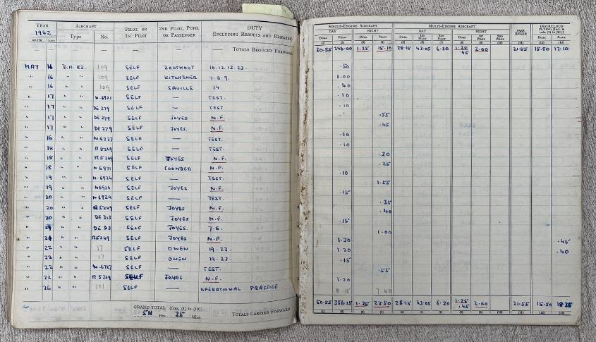
Tip: NF stands for Night Flights. A lot of experiments in flying at night were made at Cambridge Aerodrome.
Here is a photo of Wing Commander Wells’ Flying Log Book from World War II.
What information can you find out about his flights?
Notes:
Discussion points
If a pilot created this type of record today, how would it be different?
How many times a day did Commander Wells fly?
What role did he play in the plane?
What is the benefit of a second pilot, pupil or passenger?
A DH 82 is a De Havilland Tiger Moth

Slide 26
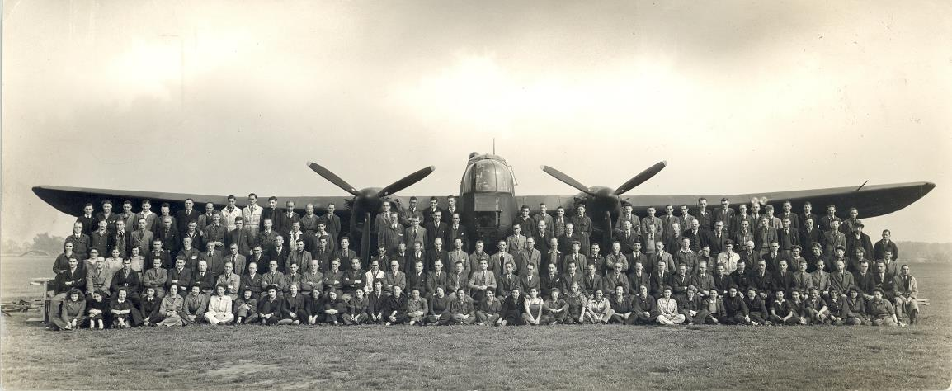
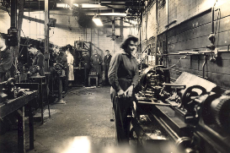
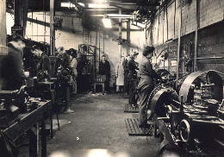
Many women joined the workforce at Cambridge Airport, helping repair planes.
The plane is an Armstrong Whitworth.
Notes:
Talking points:
Some women had worked at Marshall before WW2 – but only in small numbers and they did not work on the planes.
During WW2, the number of women working at Marshall increased significantly.
Today, there are lots of women who work at Marshall – and the company is even run by a woman.

Slide 27
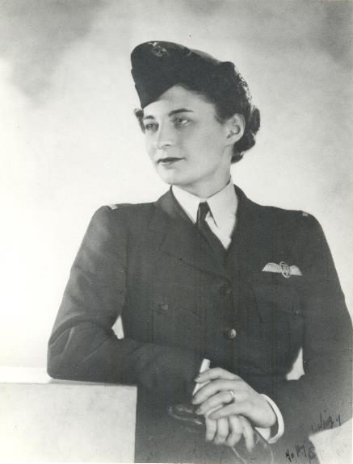
Some women also flew planes as part of the war as part of the Air Transport Auxiliary (ATA).
They flew repaired planes from places like Cambridge Airport to Royal Air Force bases.
One person who flew planes for the Air Transport Auxiliary was Molly Rose, a member of the Marshall family that built Cambridge Airport.
Between 1942 and 1945, Molly flew 486 different planes for the ATA.
Molly Rose in her Air Transport Auxiliary uniform.
Notes:
Talking point: although women didn’t fly planes in combat in WW2, they still had an important role as pilots. Many planes still needed to be flown – for instance, flying a repaired plane back to its RAF base or an important military figure to a meeting.
Molly Rose flew nearly 500 planes in three years – which shows how busy these female pilots were.

Slide 28
Imagine you are Molly Rose. You have been asked to fly a plane urgently after it has been repaired in Cambridge to an RAF base in Lincolnshire. The weather is very bad.
Write a diary entry about your flight.

Slide 29
The C-130: a famous plane looked after in Cambridge

Slide 30
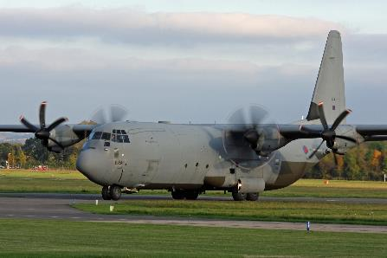
A frequent visitor to Cambridge
One of the most frequent airplanes worked on by Marshall at Cambridge Airport was the Hercules C-130.
The Hercules is a transporter plane. A transporter plane carries people, vehicles and equipment from one place to another.
The team of Marshall engineers at Cambridge Airport maintained these planes for over 60 years.
A C-130 plane at Cambridge Airport
Notes:
Talking point:
The C-130 Hercules has been a common sight in the skies around Cambridge.
The RAF no longer uses C-130 planes but many other airforces do.

Slide 31
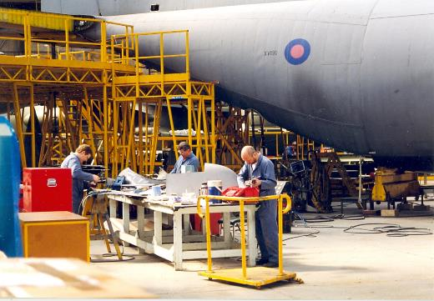
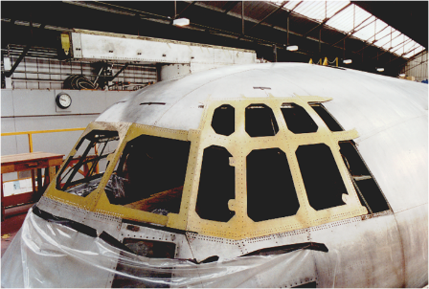
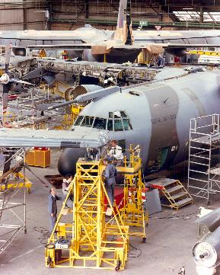
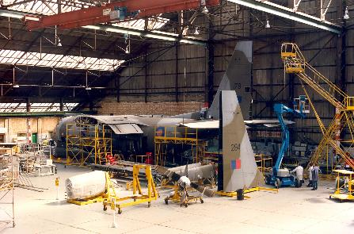
C-130 transporter planes being repaired by Marshall at Cambridge Airport.
A very large building called a hangar is needed to protect the plane during its repair.
Notes:
Talking point: some students may have seen the hangars at Cambridge Airport from Newmarket Road.

Slide 32
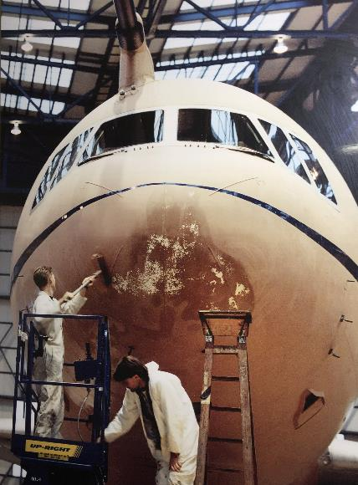
Think pink!
Painting C-130 planes to disguise them in a desert landscape.
In the 1990s, the Royal Air Force needed to use some of its C-130 transporter planes in a desert region.
But the planes’ normal green and grey colours stood out against the desert landscape.
Two planes came to Cambridge Airport and were painted a shade of pink overnight by Marshall. This pink meant the planes were harder to see against the desert.
Notes:
Talking point: why didn’t they paint the plane with camouflage?

Slide 33
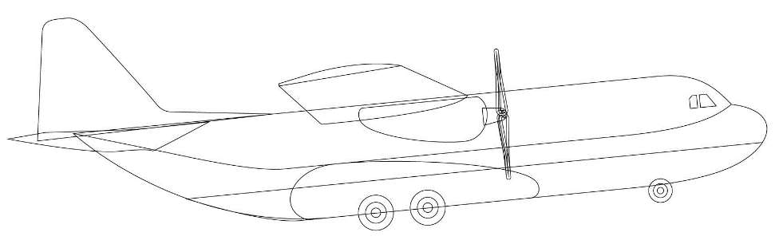
Draw on the picture to show your C-130 would carry. Its cargo often includes soldiers, food, water, doctors and nurses, parachutes, science equipment, tents, tools, all-terrain vehicles and ambulances. What would you carry?

Slide 34






Air forces in these countries fly airplanes to Cambridge to have them repaired or improved by Marshall.
Fill in the missing letters for some of the countries Marshall supports.
_ _ _ _ _ _
_ _ _ _ _ _
_ _ _ _ _ _
_ _ _ _ _ _ _
_ _ _ _ _ _ _
Some air forces supported by Marshall at Cambridge:
Austria
Bangladesh
Belgium
Cameroon
Canada
Denmark
France
Netherlands
Norway
Qatar
Sweden
United Kingdom
United States of America
_ _ _ _ _ _
_ _ _ _ _ _ _
_ _ _ _ _ _
_ _ _ _ _ _
_ _
_ _ _ _ _ _ _
_ _ _ _ _ _ _ _ _ _ _
_ _ _ _ _ _ _
_ _ _ _ _ _
_ _ _ _ _
_ _ _ _ _ _ _ _ _ _
_ _ _ _ _ _ _ _

Slide 35
Working in pairs, look up the capital city for each of the countries on the left. Write the name in Column B below. Then look up the distance in kilometres between that capital city and Cambridge and write it down in Column C. Write down the names of some other countries or seas / oceans that you would fly over between that country and Cambridge.
Country | B. Capital City | C. Distance to Cambridge, UK | D. We would fly over …
Austria
Bangladesh
Cameroon
Canada
Denmark
Norway
Qatar
United States
Notes:
Talking points: this exercise can be completed using Google Maps.
Answers:
Austria – Vienna / 1,234 km / Germany, Czechia, Belgium, North Sea
Bangladesh – Dhaka / 7,962km / several countries, including Poland, Germany, Belarus, Uzbekistan, Nepal
Cameroon – Yaounde / 5,465 km / Nigeria, Algeria, France, English Channel
Canada – Ottawa / 5,342 km / Atlantic Ocean, Ireland
Denmark – Copenhagen / 900 km / North Sea
Norway – Oslo / 1,076 km / North Sea
Qatar – Doha / 5,213 km / several countries including Kuwait, Syria, Turkey, Romania
United States – Washington DC / 5,879 km / Canada, Ireland, Atlantic Ocean

Slide 36
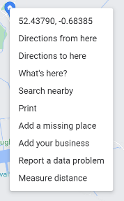
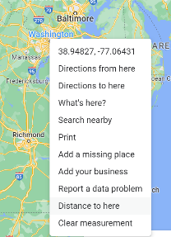
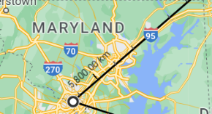
How to look up the distance between locations
On Google Maps, find Cambridge, UK.
Right click your mouse on Cambridge, UK and choose Measure distance.
Then scroll to the other location on Google Maps (e.g. Washington DC, United States).
When you find the other location, right click on your mouse again and choose Distance to here.
You will now see a black line appear with the distance on it.

Slide 37
Cambridge’s role in designing the world’s most famous plane

Slide 38
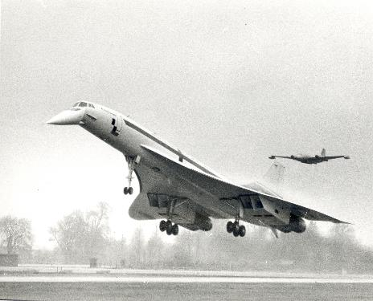
The world’s most famous plane in Cambridge
The most famous plane of all time is Concorde.
It was a supersonic passenger jet. ‘Supersonic’ means it could travel faster than the speed of sound.
The most famous element of Concorde – its nose – was designed and built right here in Cambridge in the 1960s.
Concorde’s famous nose was designed and built at Cambridge Airport.
Notes:
Talking point: Concorde is no longer in use today.
As it could only carry a small number of passengers, it was very expensive to run.
It was also involved in a very serious accident, which meant people lost confidence in it.
There are currently no other supersonic planes in use.

Slide 39
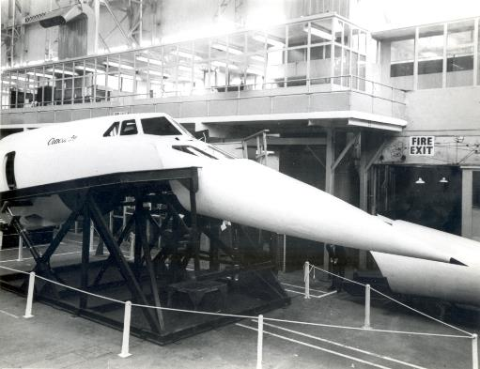
Why is Concorde’s nose special?
The nose of Concorde is aerodynamic.
This means that it is designed so air can flow easily around it, which means it could fly faster than a normal plane.
Concorde’s nose would also lift up and down. When the plane was on the runway, the nose would lower to give the pilots a clearer view from the front of the plane.
Concorde’s nose in its lowered position
Notes:
You can see a video of the nose lowering here: Concorde droop nose and visor test – YouTube

Slide 40
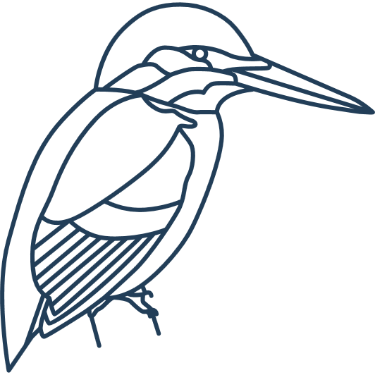





Where did the idea for Concorde’s nose come from?
OR
The Marshall designers looked to nature for inspiration for Concorde’s nose. What animals have similar noses?
Other transport designers have adopted the same ‘nose’ idea for trains and cars.
OR
Tick the options with a nose closest to Concorde.
OR
Notes:
Answers:
Kingfisher
Bullet train
Racing car

Slide 41
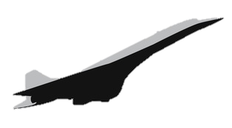
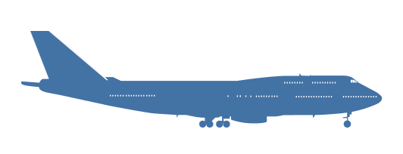
How did Concorde compare to other passenger planes?
The plane that can fly at 1,354 miles per hour is ………………………………
The plane that can carry 525 passengers is
………………………………
The plane that would take eight hours to reach New York is
………………………………
Concorde
Boeing 747
1,354 miles per hour
579 miles per per hour
Maximum speed
Number of passengers
130
525
Time to fly from London to New York
3 ½ hours
8 hours
Notes:
Answers:
Concorde
Boeing 747
Boeing 747

Slide 42
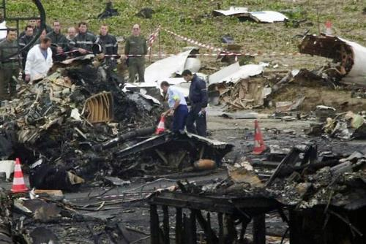
Why doesn’t Concorde fly today?
Concorde was a ground-breaking plane – but it was retired in 2003.
Why?
Its owners struggled to make money from it.
It could only carry a small number of passengers.
It used a lot of fuel that made it expensive to fly.
In 2000, there was also a fatal incident involving Concorde where all passengers and crew on board died as well as people on the ground.
It was the first time Concorde had ever had a fatal incident – but after it, people lost confidence in Concorde.
Investigators examining the debris of Concorde in 2000.
Notes:
You can see a video of the nose lowering here: Concorde droop nose and visor test – YouTube

Slide 43
What would your dream plane look like – and why?
Write a description of your dream plane. Explain how your choices might change its design – for instance, a plane that carries lots of passengers will need to be big whereas a plane that avoids detection will be much smaller.
Imagine you are a plane designer.
What features would you include on your plane and why?
For example, would it:
be able to go really fast?
carry lots of passengers or other cargo?
be able to avoid detection?
be able to take off and land on water?
have fun things in its interior for passengers, like a bowling alley?

Slide 44
Draw your dream plane.
Add labels and arrows to point out any of your design ideas (for example, special feet to land on water).

Slide 45
Saving lives by air from Cambridge

Slide 46
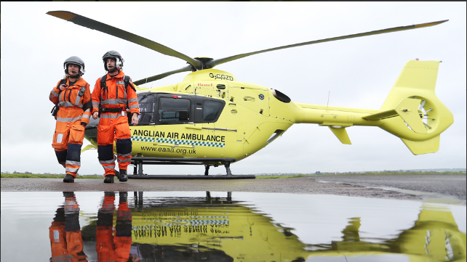
Saving lives from Cambridge Airport
Since 2010, the East Anglian Air Ambulance has had a base at Cambridge Airport.
The Air Ambulance is available 24 hours a day, 7 days a week. It flies to emergencies across Bedfordshire, Cambridgeshire, Norfolk, and Suffolk.
You can find out more about the work of the Air Ambulance: https://www.eaaa.org.uk/

Slide 47
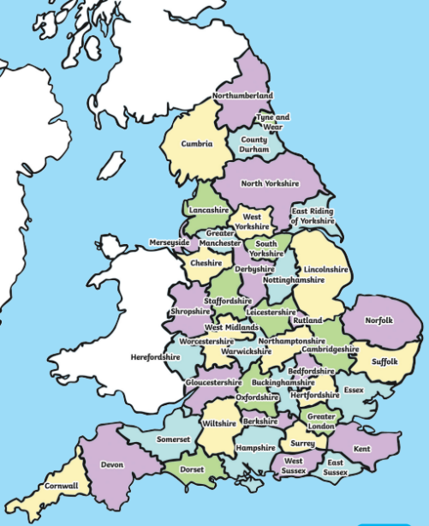
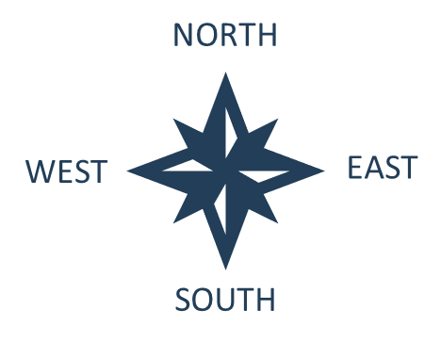
The East Anglian Air Ambulance service covers emergencies across four counties:
Bedfordshire
Cambridgeshire
Norfolk
Suffolk
Can you find these four counties on the map of England?
Mark the four counties with an X.

Slide 48
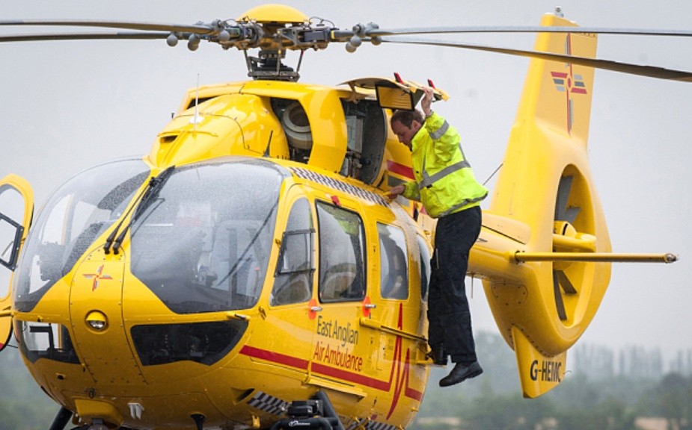
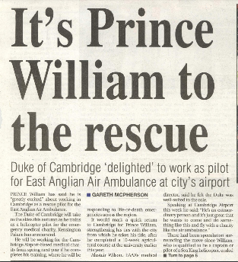
Between 2015 and 2017, Prince William worked as a pilot for the East Anglian Air Ambulance. He regularly flew helicopters from Cambridge Airport to emergencies in the East of Anglia region.
Notes:
Talking points: the East Anglian Air Ambulance still operates today

Slide 49
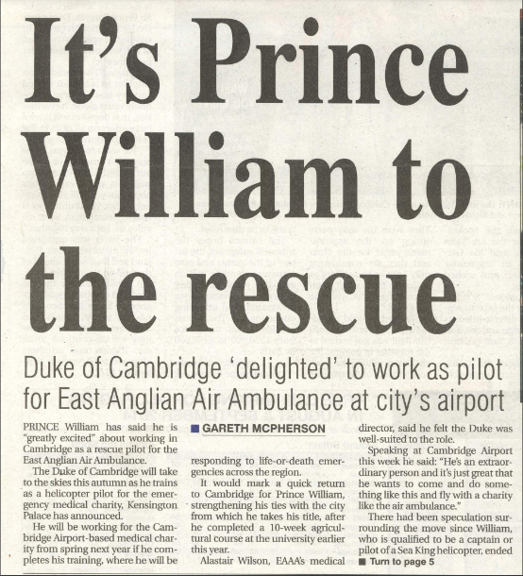
In the news!
Imagine you are a reporter on a Cambridge newspaper in 2016.
Prince William has flown an air ambulance to the site of a car crash on the A14. Everyone injured was successfully airlifted to hospital by Prince William and the air ambulance crew.
Write a short news article about the rescue. Make up a great headline.
You can use the template in these slides.
Notes:
Talking points: the East Anglian Air Ambulance still operates today

Slide 50
CAMBRIDGE NEWS

Slide 51
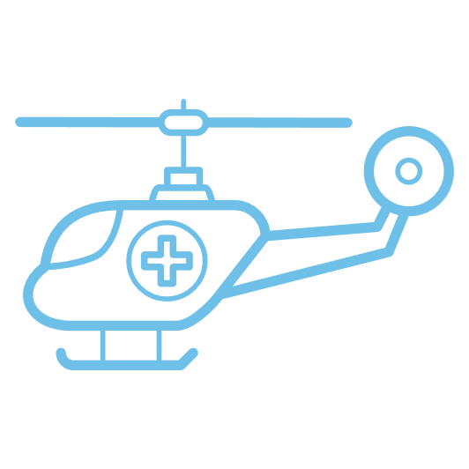
Why use a helicopter as an ambulance?
Here are some of the reasons why a helicopter can make a good ambulance.
A helicopter ambulance can:
Reach areas where there are no roads
Travel faster than a car or van
Avoid traffic jams on the road
Take off and land without a runway
Here are some of the reasons why a helicopter doesn’t make a good ambulance.
A helicopter ambulance:
Is expensive to run
Needs trained helicopter pilots to fly. This training takes a long time.
Can’t be used in bad weather, like a storm

Slide 52
True or false?
Decide if the statement is true or false. Put a tick (✓) in either the TRUE or the FALSE column to show your answer.
 | TRUE? | FALSE?
Anyone can fly a helicopter without training.
A helicopter can reach places where there aren’t any roads.
An ambulance driven on the road will travel faster than a helicopter ambulance flying in the sky.
You can fly a helicopter safely in any weather.
Prince William once worked as a helicopter ambulance pilot in Cambridge.
Notes:
Answers
False
True
True (most of the time). Helicopters can fly faster than an ambulance can drive.
False.
True

Slide 53
About airports

Slide 54
Departure Board
Time: 09:45
Departure Board
 | Code | Number | From | To | Expected | Status | Gate
 | MAD | 356 | Cambridge | Madrid | 10:00 | Boarding | 12
 | SYD | 981 | Cambridge | Sydney | 10:30 | Boarding | 3
 | JFK | 200 | Cambridge | New York | 10:45 | On time | 6
 | GLA | 763 | Cambridge | Glasgow | 11:00 | Delayed | 1
 | FCO | 882 | Cambridge | Rome | 13:30 | On time | 9
Look at this imaginary departure board for flights from Cambridge.
It is currently 09:45. How many minutes is it before the Madrid flight takes off? ……………………………….
Which flight is leaving from Gate 3? ……………………………………………………………………………………………………
Is the flight to Glasgow on time? ………………………………………………………………………………………………………..
What is the destination for flight numbered 200? ………………………………………………………………………………
Notes:
Answers:
15 minutes
981 to Sydney
No, it is delayed.
New York.

Slide 55





Jobs at an airport
There are many types of jobs at an airport. Here are a few examples. What jobs have you learned about already? Discuss with your group which one of these jobs would you most and least like to do. Why?
Air Traffic Controller
An air traffic controller manages the flow of planes landing and taking off at an airport. This protects the planes, their crew and passengers by making sure there are no collisions.
Border Force Officer
As an airport is a point of entry into a country, a border force (or customs) officer makes sure that people who enter have the right permissions to land (for example, checking passports and visas). They also check any cargo on the plane (for example luggage or animals) can be legally brought into the country and that the right amount of tax has been paid, if needed.
Aircraft Engineer
An aircraft engineer provides regular maintenance to planes to make sure they are as safe as possible when flying. They will also make repairs or upgrades to planes.
Baggage handlers
A baggage handler makes sure all the cargo is safely stored in the plane ahead of each flight – and then also removes cargo, such as luggage, from the plane at the end of each flight.
Flight crew
Pilots fly planes between destinations. Flight attendants support passengers during the flight, making sure all the safety rules are followed.
Notes:
Talking points:
What other examples of jobs can people think of?

Slide 56





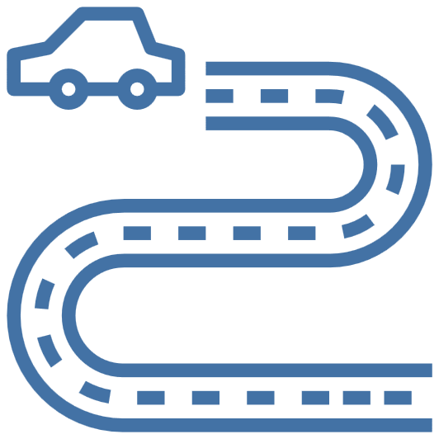



Your own airport
In your groups, discuss if you had to build an airport, what features would you choose for your airport location?
Why?
Tick all the features that you would choose
On bumpy ground
Near houses
Near tall buildings
In a windy spot
Easy to reach by road
Near mountains
Space for a runway
Close to a city like Cambridge
In the countryside
Notes:
Talking points:
There are different reasons for and against various features.
For instance, building an airport near houses means the people who live in the houses will hear a lot of noise. But it does mean there is somewhere convenient for the airport workers to live.
Similarly, building in the countryside might mean there is less disturbance from the airport – but it also means it is further for people to travel.

Slide 57


An airport from above
Here is Cambridge Airport in 1945 and in 2023. The location is the same. Can you spot any similarities and differences?

Slide 58


Comparing airports
Use Google Earth to find and look at three UK airports:
Cambridge Airport
Heathrow Airport
London City Airport
Discuss the following questions:
What buildings do you notice in the three airports?
How do their sizes compare?
How many runaways does each airport have?
What do you notice about their locations?
Apart from buildings, what else can you see at each location?
Heathrow Airport
London City Airport

Slide 59




Design your airport
When you have decided what you want to include in your airport, take a large piece of paper and draw your airport.
In your groups, brainstorm some ideas for your ideal airport.
Here are some ideas for what you could include.
All airports need a runway. The runway has to be long enough to allow the plane to build up speed to take off and slow down when landing.
Air traffic controllers need a tower with big windows to see all the planes taking off and landing.
Passengers need buildings when they are getting ready to fly or landing. Where will their tickets and passports be checked?
Planes need to be kept somewhere when not flying. They also need to be cleaned, repaired and refuelled somewhere.
Don’t forget to choose a name for your airport!
Present your airport back to the rest of the group when ready.

